Slide 1
Tactile Augmentation
Anja Musch, Melanie Hluchnik, Mathias Jenter, Sebastian Penhouet, Denis Heid
Practical Course Avatars in Virtual Realities February 28, 2018

Slide 2
Introduction
Virtual objects are not physically present → No haptic
Tactile feedback on touch → Vibration motors on fingertips simulate haptic
Test haptic object perception

Slide 3
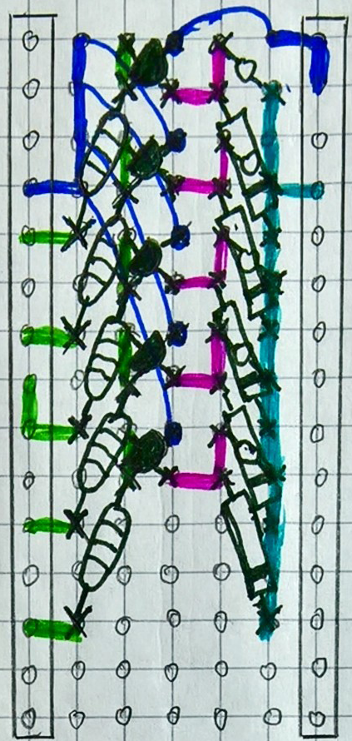
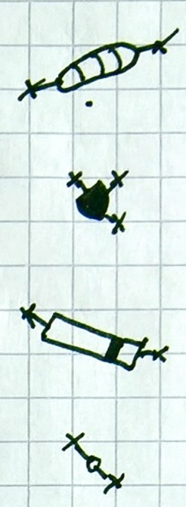
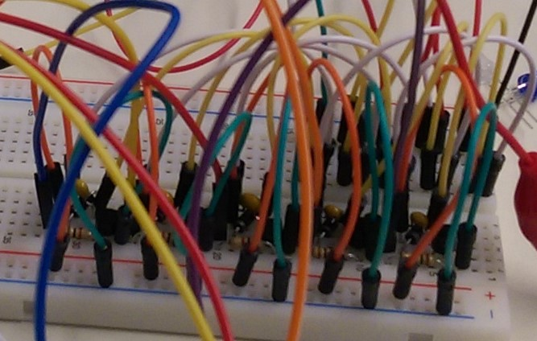
Protective circuit on PCB
- GND
Perfboard
Size of Arduino
Stacked on top
Stacked components
GND -
- 5V
Resistor
PWM -
Transistor
PWM -
PWM -
Diode
PWM -
PWM -
Condensator
PWM -

Slide 4
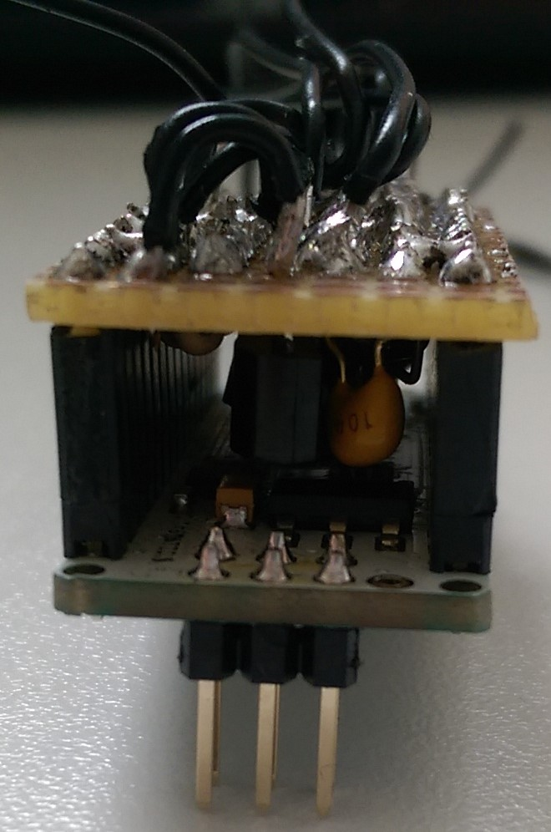
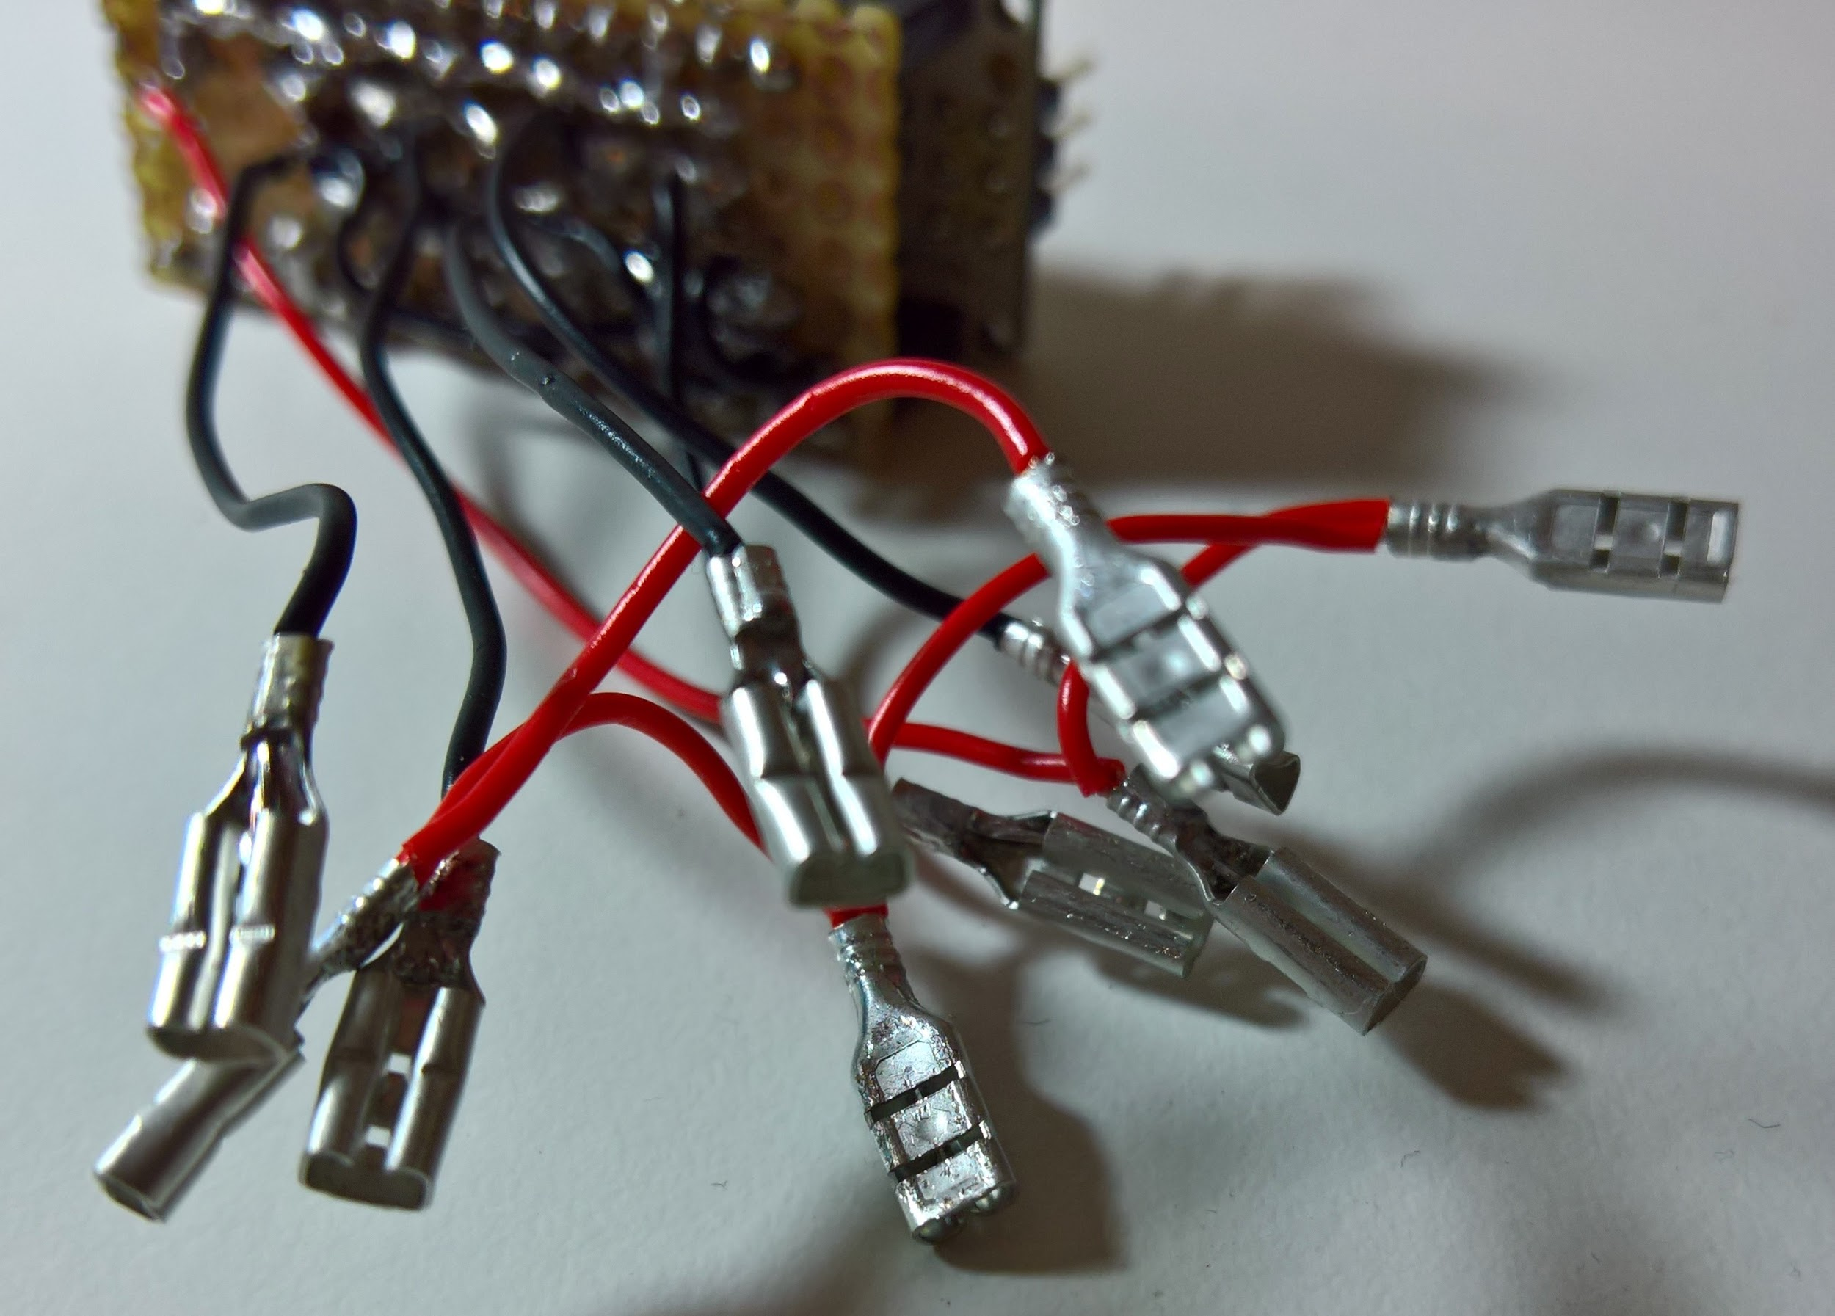
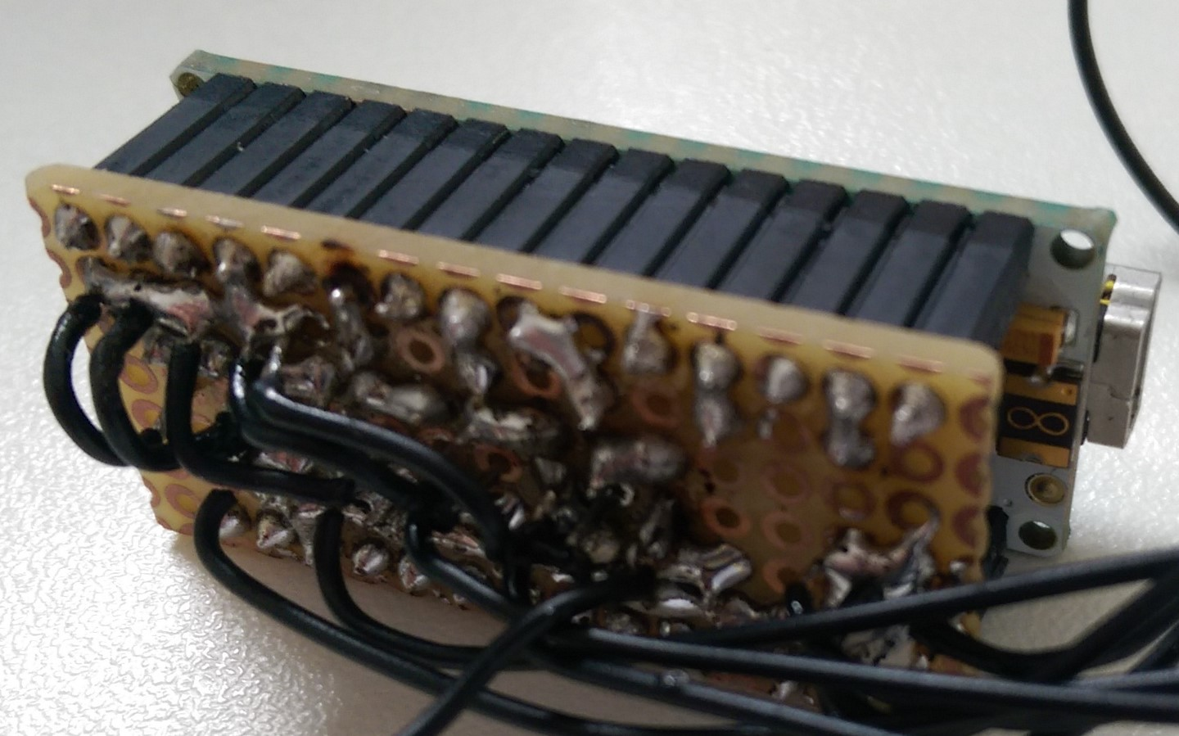
PCB soldering
Solder & cable jumpers
Pluggable (Arduino & external Interface)

Slide 5
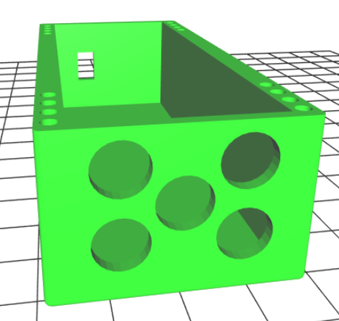
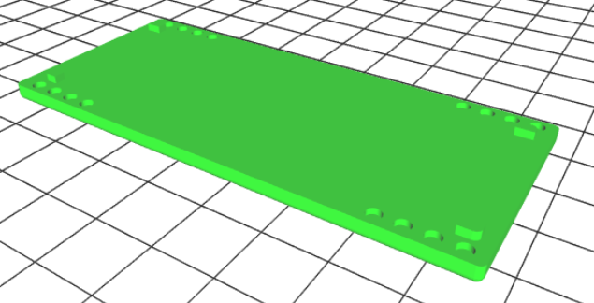
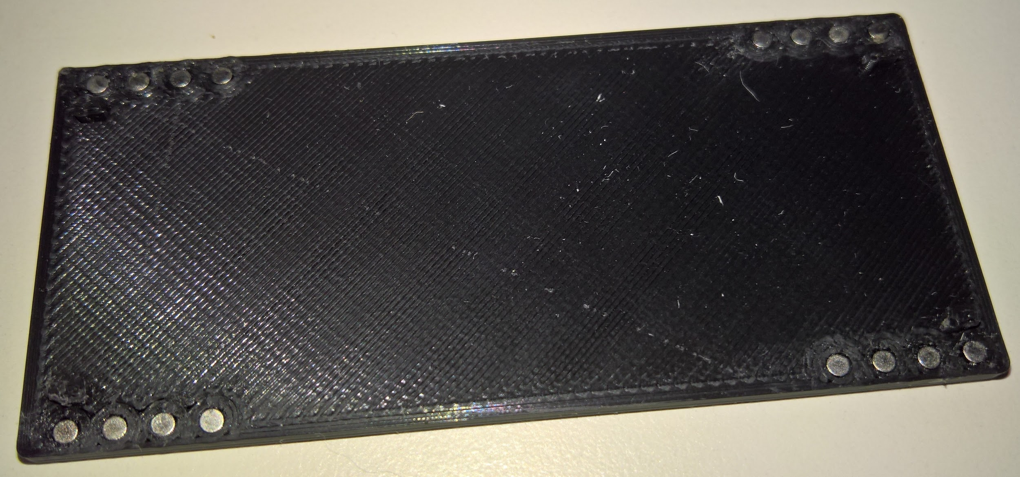
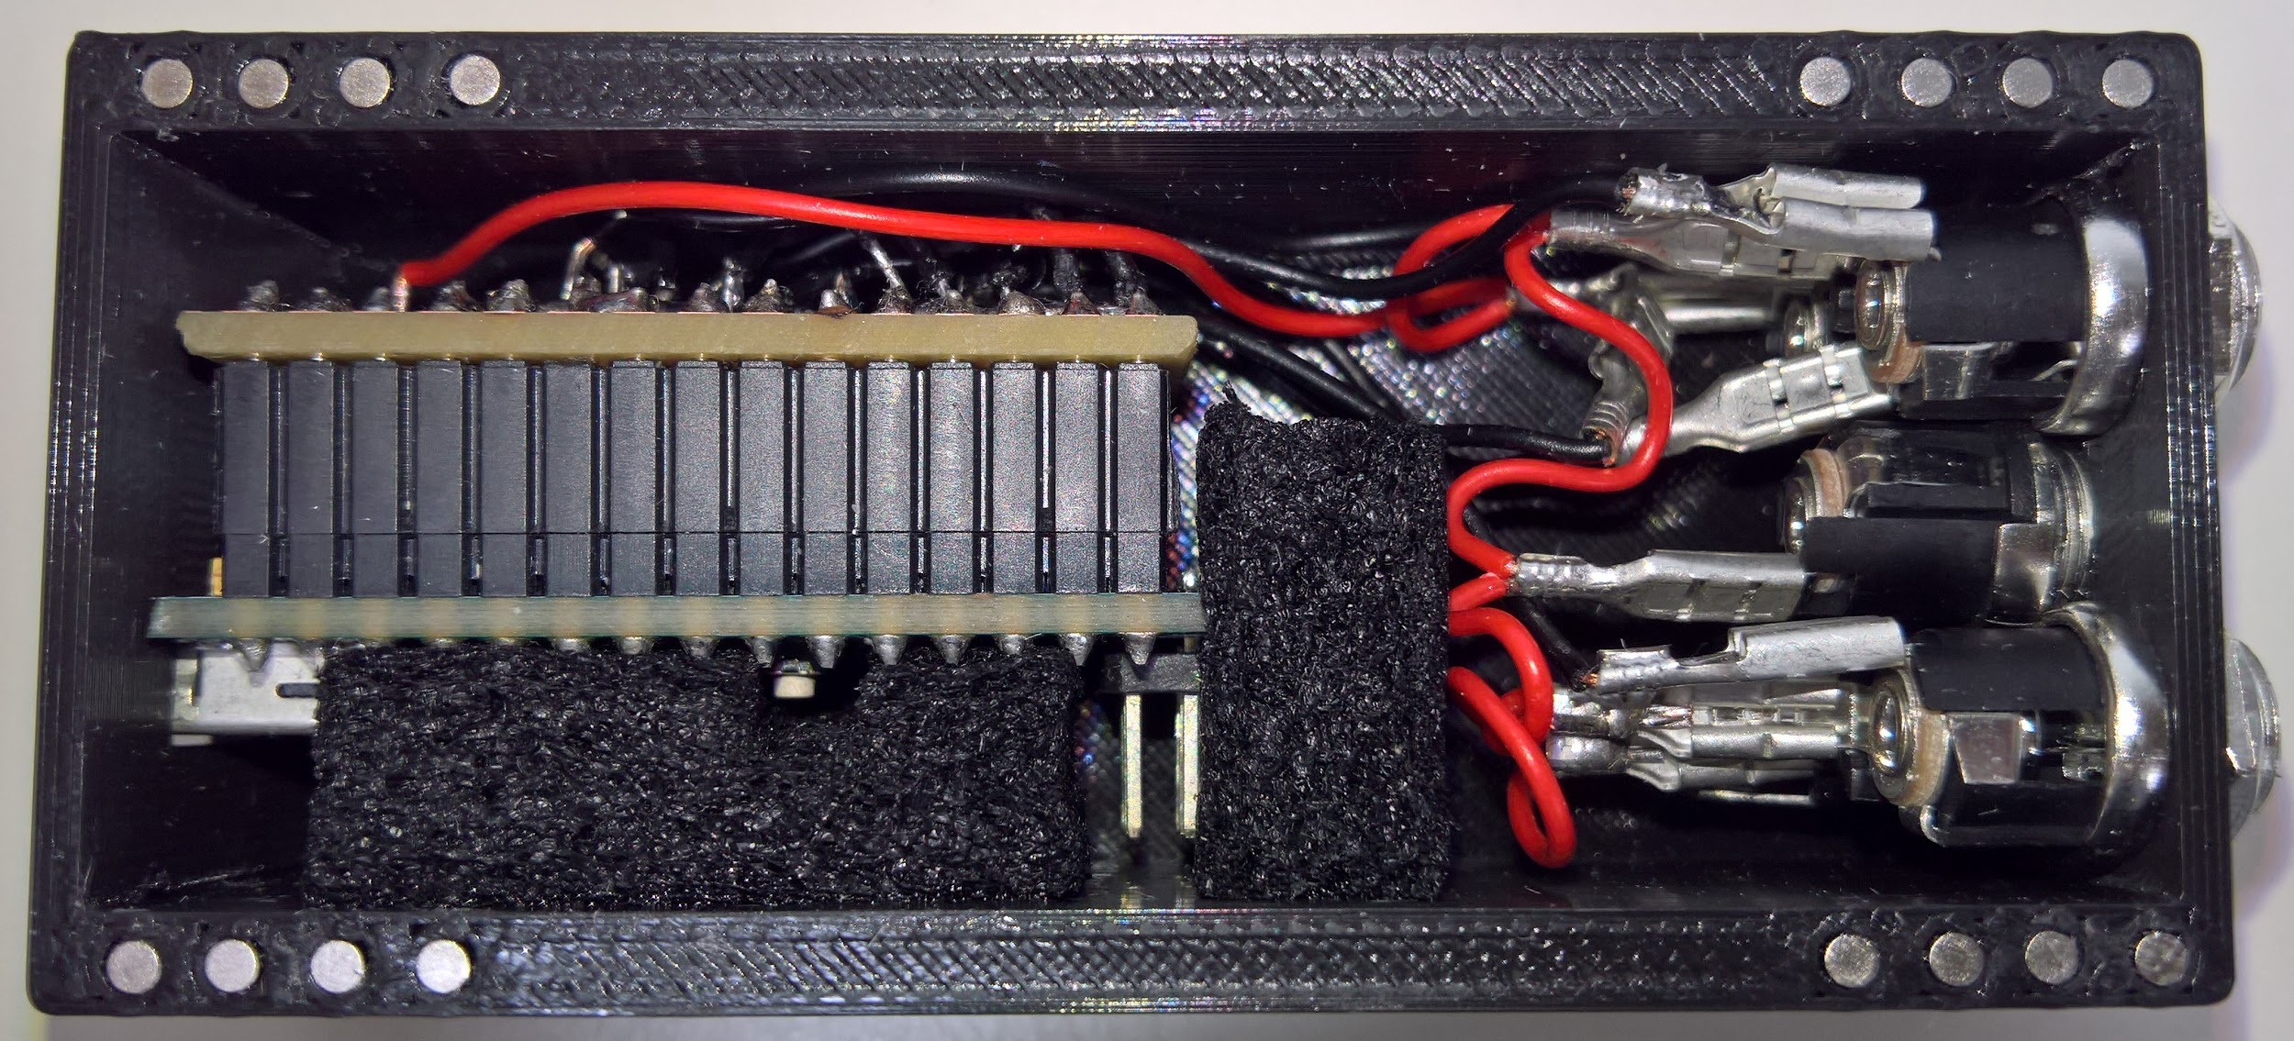
3D-case design & print
FreeCAD instead of Blender
Lid with magnets
Round edges
Cut outs for USB and Motor-Interface
Printed by Fabian Schrodt
Printer incident

Slide 6
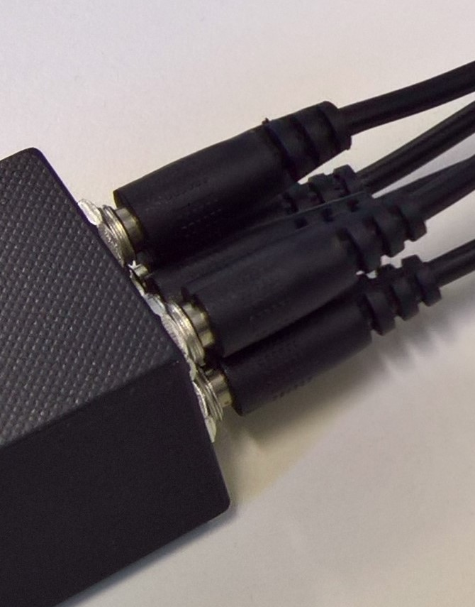
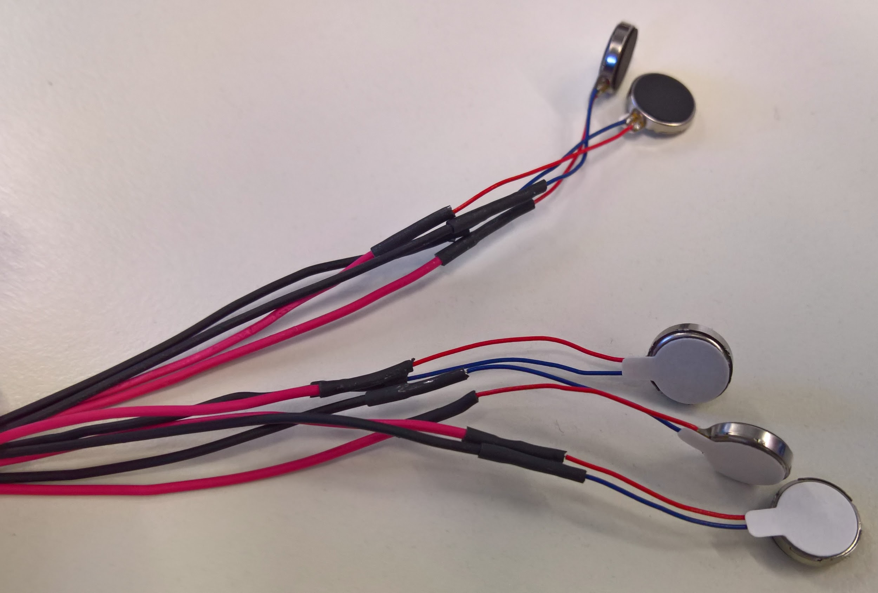
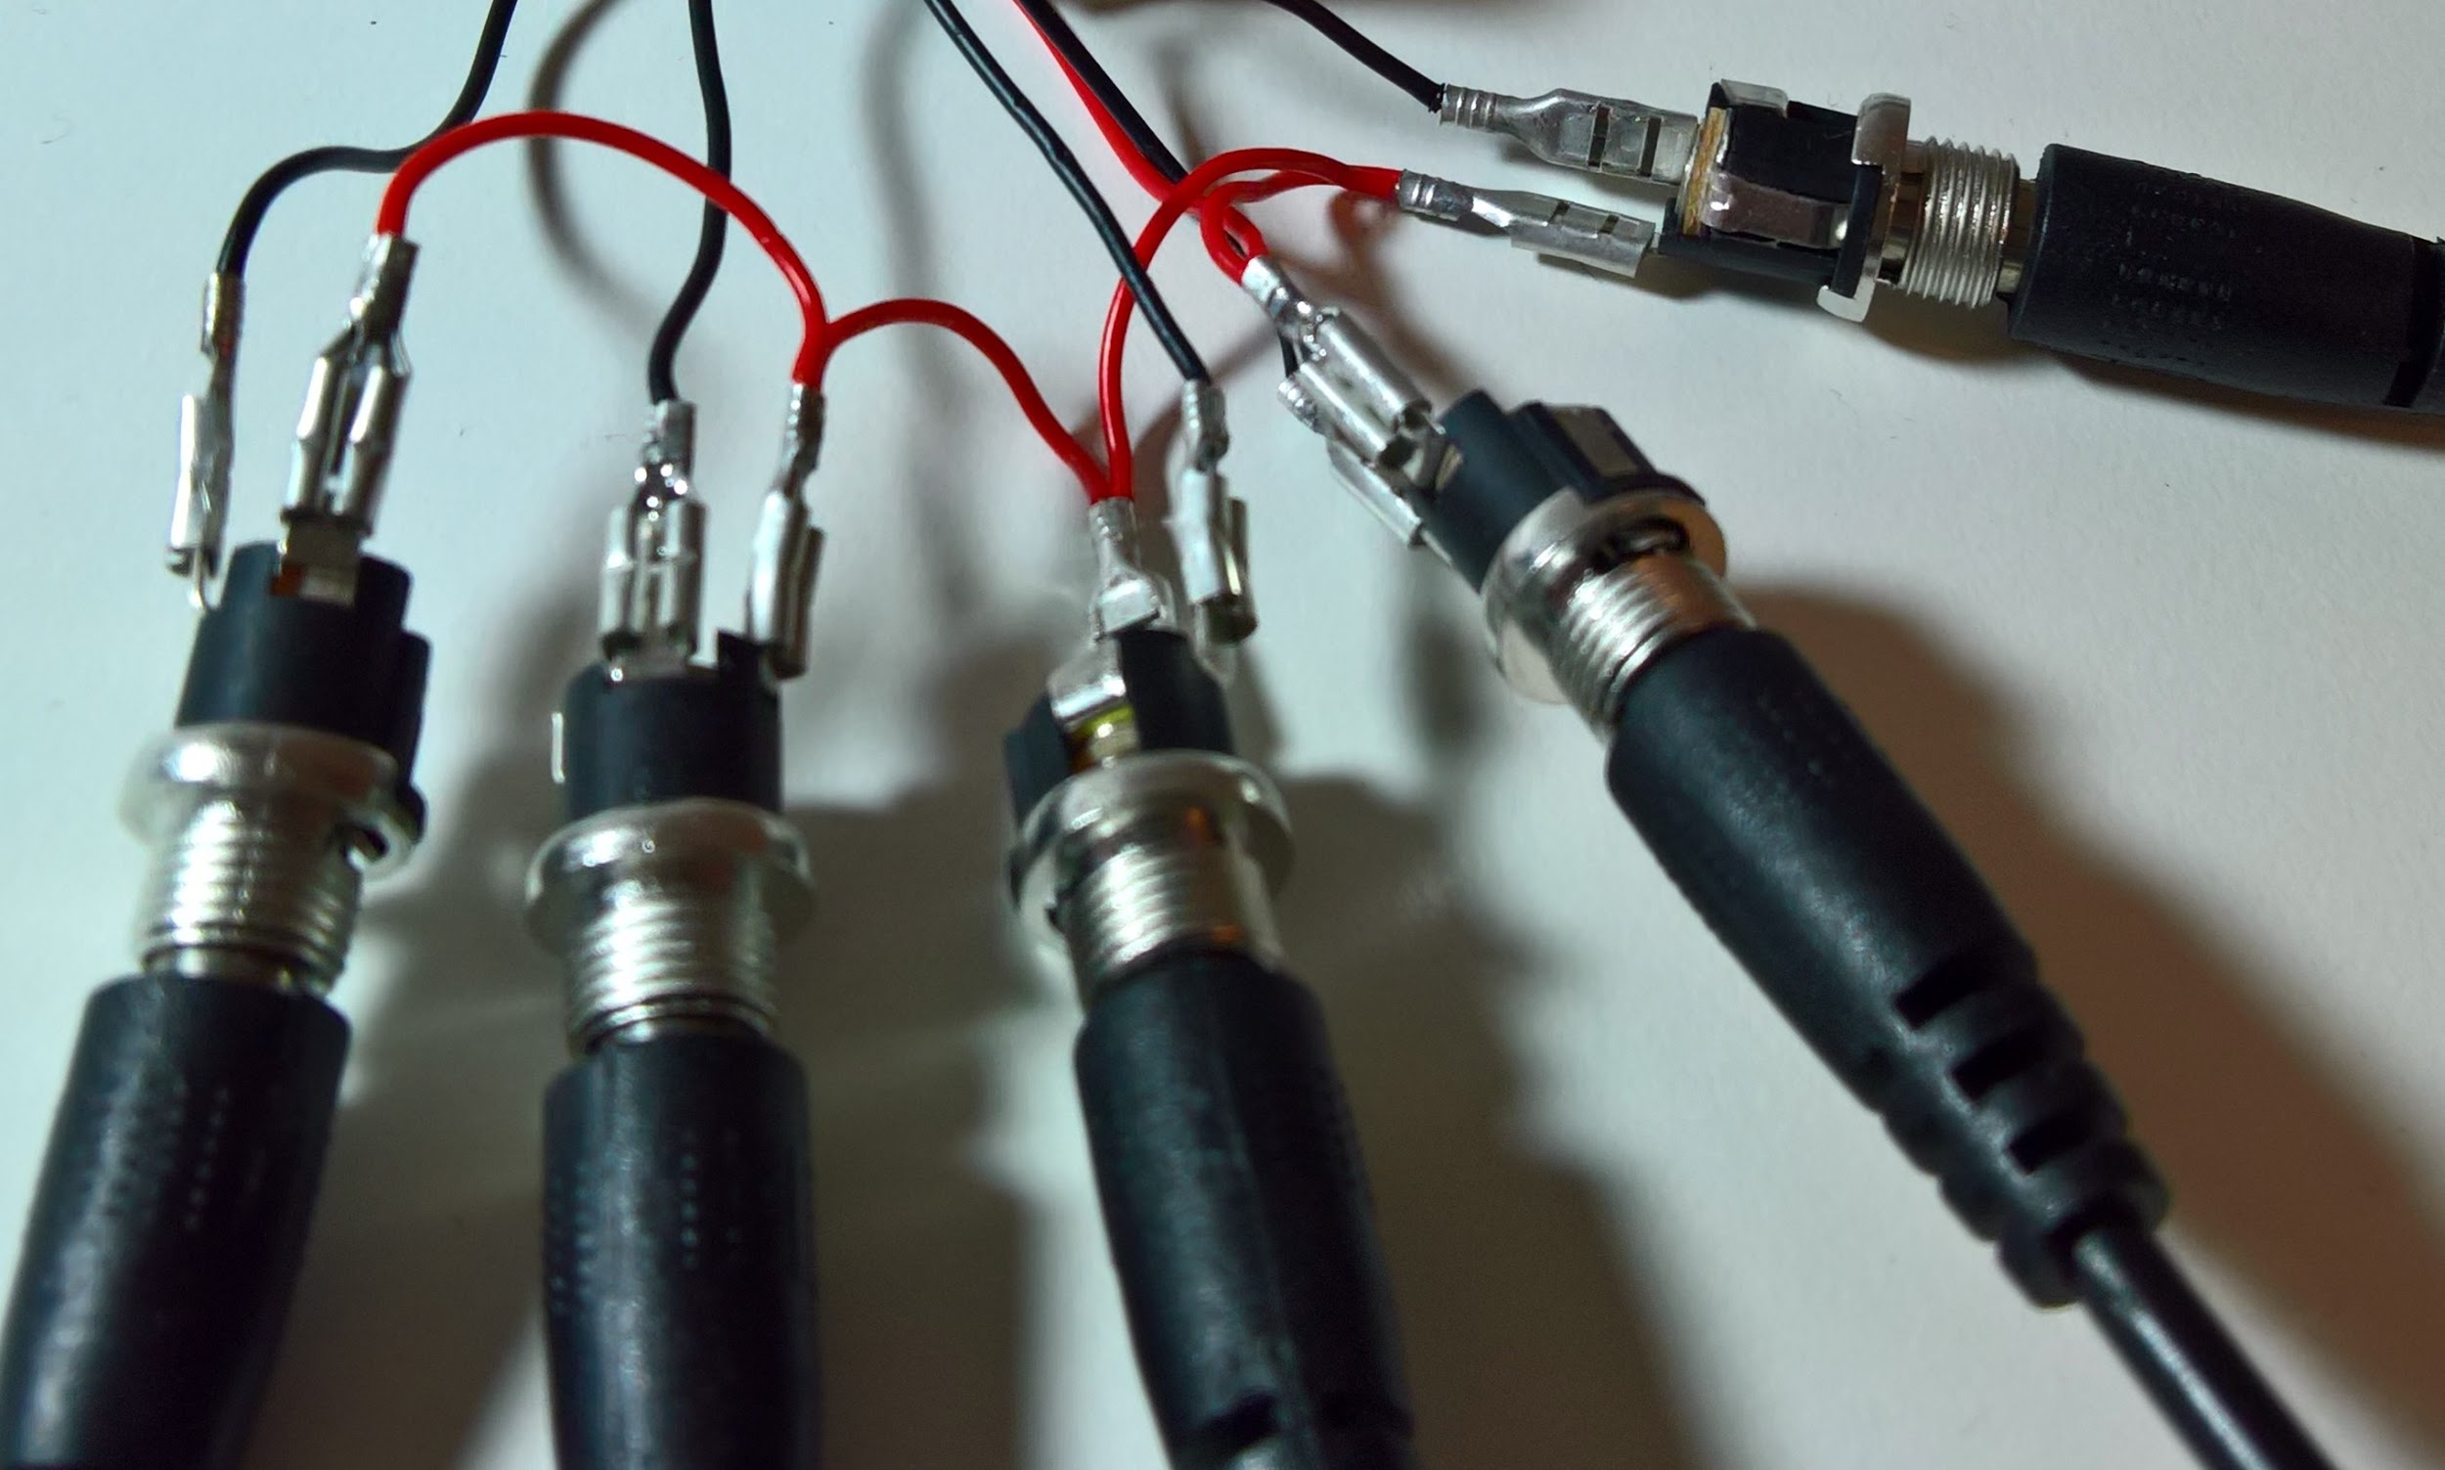
Vibrator motor interface
DC Power Connector Cable per motor
Pluggable

Slide 7
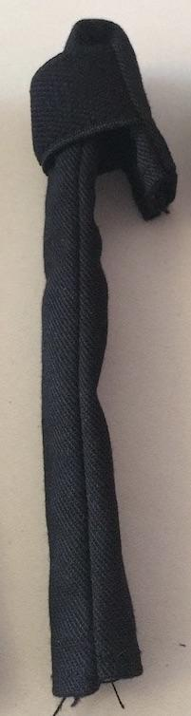
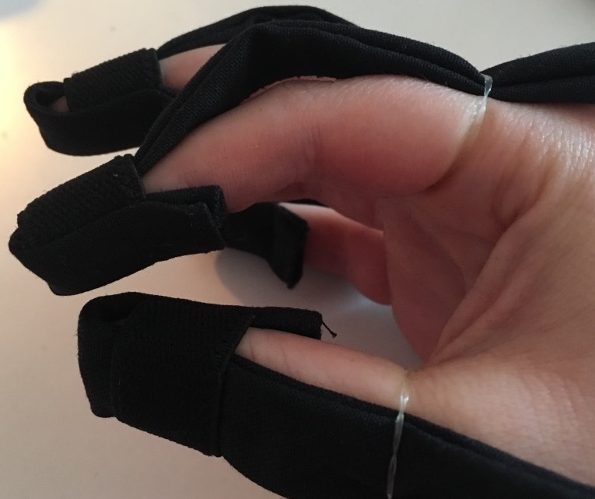
Finger stalls
Tube for the cable
Elastic tape to fix on the finger
Multiple finger stalls in different sizes

Slide 8
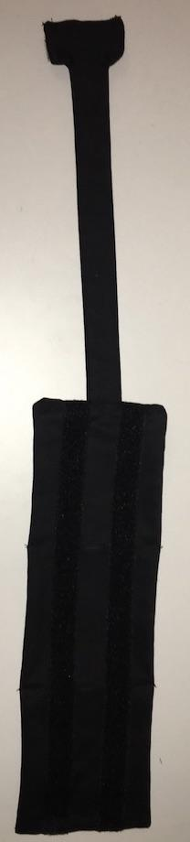
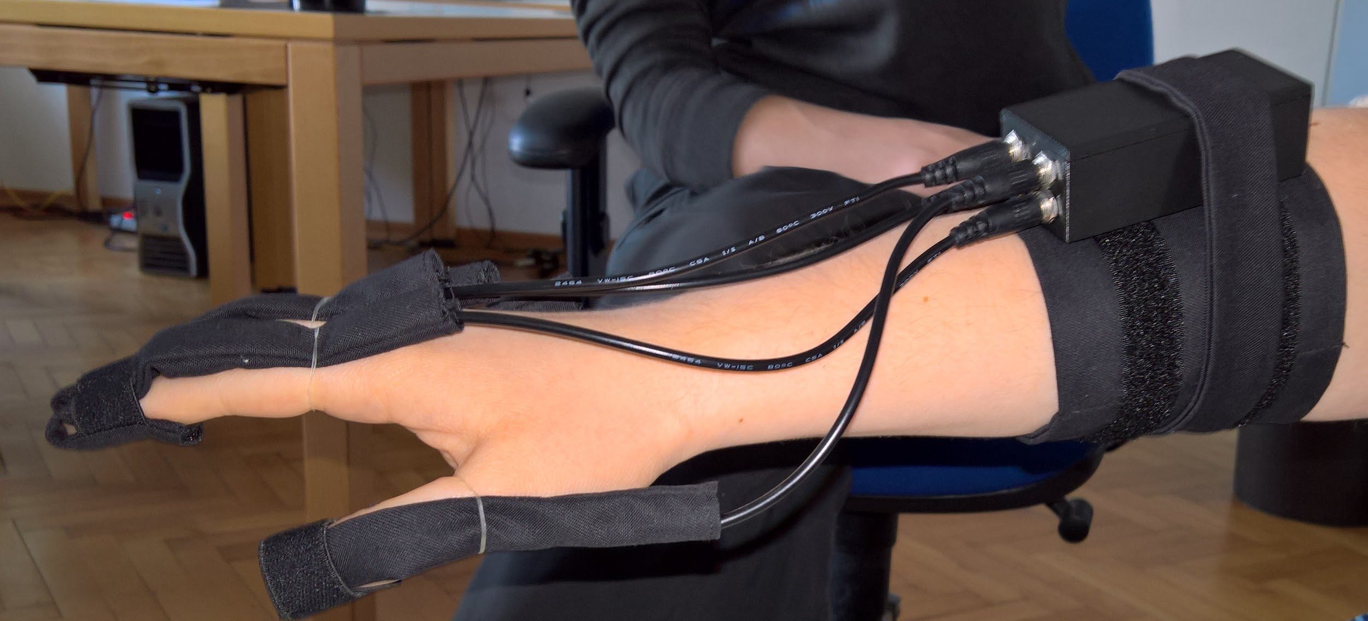
Wristband
Fix the Arduino with Velcro straps

Slide 9
Arduino - Unity interface
Unity interface sends the data over a serial port
Each finger has its own value
Data send from Unity are percent values (0%-100%)
Arduino reads the stream and calculates values between 0 and 255 (1 Byte)
Calculated values send to the specified port (PWM)

Slide 10
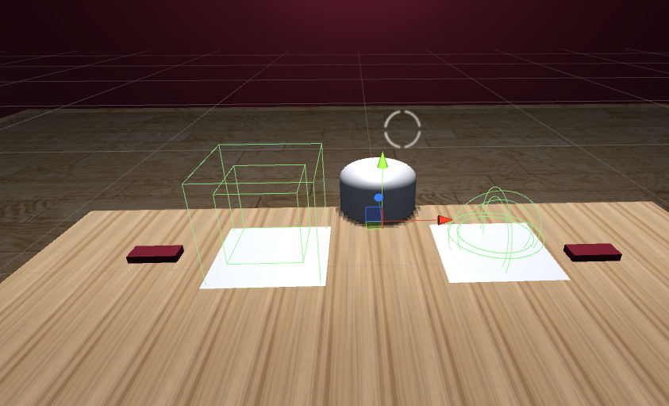
Game
idea: find the object that you can see
There are two hidden objects
Explore the outlines & choose one

Slide 11
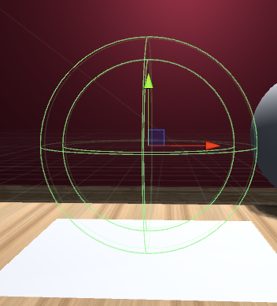
Edge contact detection
with 2 colliders: A smaller one inside a larger one
The larger one minus the smaller is representing the outline of an object
the smaller one the interior

Slide 12
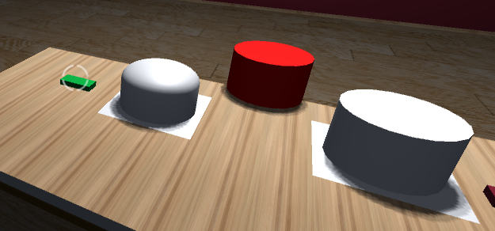
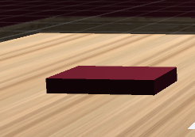
Raycast
Submit the answer with a raycast from the crosshair
One fixation point on each side
Change color while fixated, after one second shows if the answer was correct

Slide 13


Conclusion
Soldering took too much time → etching / printing circuit board
Waterfall like project progress → split teams early, parallel work
Managed to finish only one glove
LEAP controller: mostly laptop incompatible, obscure issues
Nice compact package compared to the previous version
Neat game mechanic

Slide 14
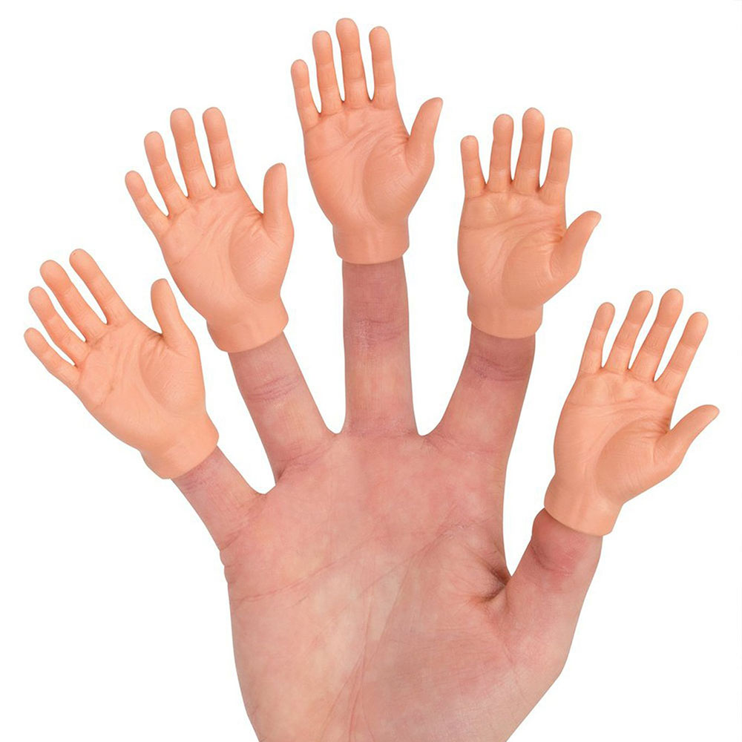

Live Demo / Hands-on
Hands-on

